Slide 1


Unit 03 Professional Practice
Lesson 7
HND in Computing
Assessor: Mafaza Nazar

Slide 2
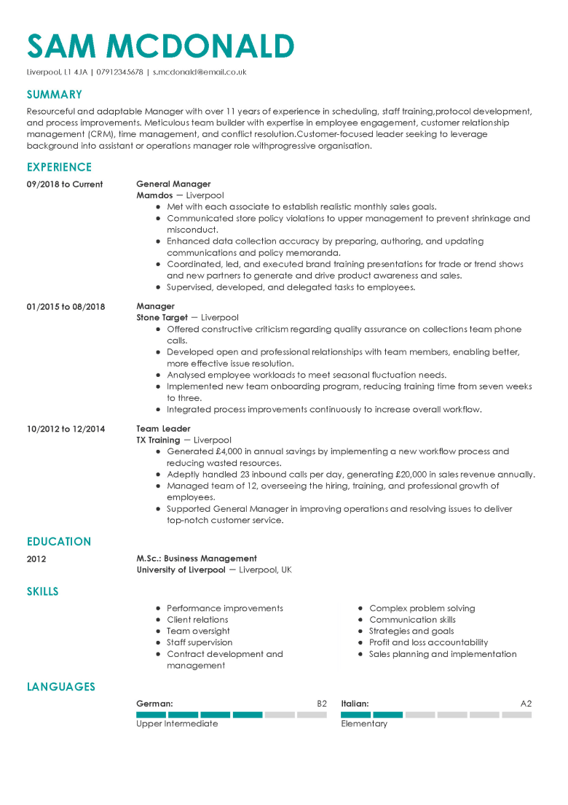
Writing Effective CVs

Slide 3
Lesson Objectives
By the end of this lesson, you will learn:
Styles of CV
Contents of CV
The grammar of effective CV writing

Slide 4
Warm-up Activity
Examine the advertisements provided and list the following:
Skills
Qualifications
Knowledge
Other attributes IT companies look for in a potential employee

Slide 5

Getting started..
Before starting the writing of your CV, it’s important to think about yourself and what you can offer.

Slide 6
Activity 1
Skills | Education Evidence | Activities & Interests Evidence | Work Experience Evidence
Comm. Skills: Written & Oral
`Time/Project managment
Organization, Administrative
Teamwork
Problem Solving
Drive & Initiation
Language (Level of fluency)
Leadership
Commercial Awareness
Other
Notes:
Thinking of your education, activities and interests and work experience, write examples of evidence you have to show an employer you possess the skills highlighted in the table. Individual Activity.

Slide 7
Styles of CVs
Chronological (biographical ) CV
Skills- based (Competency-based) CV
Combination of the two?
Which style is suitable for you? Why?
Notes:
Chronological is useful when you have
a lot of relevant experience in the sector you are applying to
✓ a relevant degree/postgraduate qualification
✓ logical career development
✓ no gaps in your work experience and education
Skills based is useful of you,
you have very little work experience or relevant work experience e.g. you are applying for your first full time job after your degree or postgraduate studies
✓ you are changing career – you have experience and qualifications in one area but are now wanting to work in a different sector
✓ you have gaps in your education or work experience

Slide 8
Activity 2
Examine the sample CV given and list its content/major sections.
Notes:
Pair work. Tell the students that there are various styles and formats they can use. Most of them are available on the Internet. There are no hard and fast rules about format, the basic essential sections should be included.

Slide 9
Content of CV
Identification
Educational/Academic Qualifications
Professional Qualifications
Work Experience
Awards & Achievements
Extra Curricular Activities
Skills & Strengths
Personal Details
References
Notes:
Identification: ur name, contact details (address, Tel no, email)
Edu Quali & Prof. Quali: start with the most recent ones, time required to complete them should be indicated as well.
Awards & Achievements: list the awarding organization and dates (year wud do)
If you don’t have extra curricular activties, u can list interests and activities , such as mountain climbing, reading, etc. the idea is to prove that u r not just a bookworm but an all rounder, with an open mind.
Should provide evidence for your skills, give examples
Should have proof of all u have listed in the CV
When putting details of referees, be sure to obtain prior approval, list the details accurately and to provide them with a copy of ur CV.
U can even add a photo to ur CV

Slide 10

Writing the CV
Objective statement
Resume profile
Notes:
Students could use either an ‘objective statement’ or a resume profile. both are optional though.

Slide 11
Objective Statement
A short but relevant statement as to what the applicant is looking for
E.g:
A motivated first year undergraduate with strong interpersonal skills looking for a part time customer service role
To obtain an excellent learning experience as an intern in the field of database design and development
Notes:
You need to customize the objective statement to suit the company, the job you are applying for. It has to be specific, concise and clear.

Slide 12
Contd.
To obtain a position that will enable me to use my strong organizational skills, educational background, and ability to work well with people
To obtain a position in the field of human resource management, where I can effectively utilize my expertise in employee relations and staff recruitment

Slide 13
Objective Statement Tips
Keep it job focused
Concise writing is critical
Avoid general statements
(“seeking a position with the opportunity for growth and advancement” or “seeking a position to advance my career.”)

Slide 14
Activity 3
Choose one of the advertisements provided and write an objective statement to suit the requirements.
Notes:
Work in groups of 3

Slide 15
Resume Profile
It’s a brief summary of your skills, work experience, and goals written for a specific job opening. It basically answers the question ‘What can you offer our company?’
e.g.-
An experienced computer scientist with a successful track record of applying theory to provide practical solutions to business problems.

Slide 16
Tips for Effective CV Writing
Use language that is positive, professional & enthusiastic
Use action verbs
Eg: Achieved, Developed, Negotiated, Produced, Analyzed, Implemented, Organized, Researched, Conducted, Initiated ,Persuaded, Created, Managed, Presented
Use effective but short sentences
Check grammar & spelling
Keep your CV to 2 pages.

Slide 17
Grammar tips for effective CV writing
Use active voice to describe your experience.
Increased productivity by 10%.
Avoid over-using the personal pronoun I.
Implemented a system to dispose garbage efficiently.
Use simple past to report education or employment that has been completed.
Completed a Diploma in Java Programming
Use present continuous to report current study or ongoing activity.
I am carrying out research into…

Slide 18
Assignment
Create your CV and submit a hard copy to the Department of Computing 4th of July 2024 before 2.30 PM.

